Slide 1
Polymers
Dr. Jitendra Satam

Slide 2
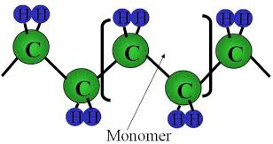
A polymers are macromolecule with high molecular mass compound ranging from 5000 to one million
Formed by combination of one or more low molecular weight compounds. The smallest unit from which polymer is obtained is called monomer.
The process by which polymers are obtained is called polymerization
For e.g. polyethylene is obtained by repeating ethylene unit as a result of polymerization.

Slide 3
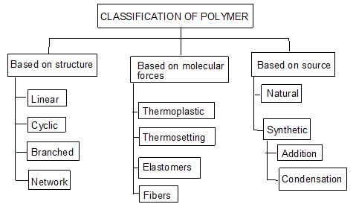

Slide 4
Classification based on source
Naturally occurring Polymers: These occur in plants and animals and are very essential for life e.g. starch, cellulose, amino acids, etc.
Synthetic polymers: These polymers are prepared in laboratory they are man made polymers e.g. plastics, synthetic rubbers, etc.
Semi synthetic polymers: These are derived from naturally occurring polymers by chemical modification. e.g. vulcanized rubber, Cuprammonium silk and Cuprammonium rayon, etc.

Slide 5
Classification based on Molecular forces
Polymers are classified into four categories based on magnitude of intermolecular forces
Elastomers: In these polymers, chain are held by weakest intermolecular forces which permits the polymers to be stretched. The polymer regains its original position when forces are released.
Fibers: In these polymers the inter molecular forces are strong due to hydrogen bonding, cross linking, cyclic structure
Thermoplastics: These are polymers for which inter molecular forces between elastomers and fibers. Due to this they can be easily molded by heating.
Thermosetting polymers: Thermosetting polymers undergo chemical changes and cross linking on heating and become permanently hard and infusible.

Slide 6
Classification based on Tacticity
Isotactic polymers: In isotactic, all the functional group lie on the same side of chain
Syndiotactic polymers: In syndiotatactic, functional group arrangement is alternate

Slide 7
Atactic polymers: In atactic, functional group arrangement is random
Every other carbon in the chain is a stereo-center

Slide 8
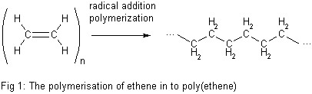
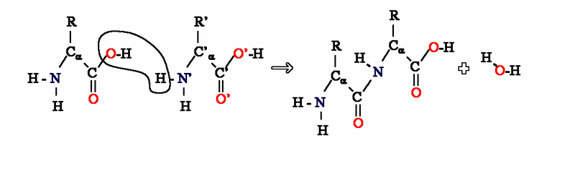
Classification based on Polymerization method
Addition Polymerization: A polymer formed by direct repeated addition of monomers is called addition polymerization. In this types of polymers monomers are unsaturated compounds or derivatives of alkenes.
Condensation Polymerization: Condensation polymerization involves condensation of two different monomers which are normally bi functional group. During the process there is loss of small molecule such as water

Slide 9
Plastics
Plastic is a substance that can be easily moulded into a desired shape by the effect of mechanical force & heat.
In the manufacturing of plastic raw materials like coal, petroleum, cellulose, salt, sulphur, limestone, air, water etc. are used.
Plastics as engineering materials:-
Low fabrication cost, low thermal & electrical conductivities, high resistance to corrosion, Plastics are resistant to chemicals & solvents
Plastics reduce noise & vibrations in machines
Plastics are bad conductors of heat are useful for making handles used for hot objects, most plastics are inflammable.
Plastics are electrical insulators & find large scale use in the electrical industry.
Plastics are clear & transparent so they can be given beautiful colors.

Slide 10
Compounding of plastics
The process of mechanical mixing of various additives with polymers (resin) to impart some special properties to the plastics.
The additives gets incorporated with resins to give homogeneous mixture.
The principle Additives / Ingredients used in compounding are:
Resin or Binder
Fillers or extenders
Plasticizers
Pigments or Dyes
Activators, catalysts or accelerators
Lubricants
Stabilizers

Slide 11
Fabrication (Molding) of Plastics
Giving any desired shape to the plastics (granules or powders) by using mould under the application of heat and pressure. A proper method is to be selected depending on the shape and type of resin used. Methods involves partial melting of resinous mass by heating.
In case of thermo-plasts molten resin is introduced in die/mould and desired shape could be achieved by compression and further cooling.
In case of thermo-sets partially polymerized mass or raw materials are introduced in the die/mould, which further cured at high temperature in the mould itself to achieve desired shape.
Note:
In case of thermoplasts, curing is done at room temperature (low temperature), while in case of thermosets, curing is done at high temperature to obtain desired cross-linking

Slide 12
Four important types of fabrication Methods
Compression Molding : (Suitable for Thermosets / Thermoplasts)
Injection Molding : (Suitable for Thermoplasts)
Transfer Molding : (Suitable for Thermosets)
Extrusion Molding : (Suitable for Thermoplasts)

Slide 13

Compression Molding
Common and oldest method for molding thermosetting / thermoplastic materials
Compression of raw materials or soften resinous mass is done in the mould/die under heat and pressure
Predetermined quantity of raw materials is introduced carefully in the mould, further compressed by hydraulic pressure (2000 to 10000 psi)
Molten or soften resinous mass gets filled in the cavity of mould.
Curing is done by heating (Thermosetting) or by cooling (Thermoplastics)
Finally moulded article is separated from the mould by opening the mould apart.
Applications : Electric switch boxes, Ash trays, cabinets for radio, television, computers etc.

Slide 14
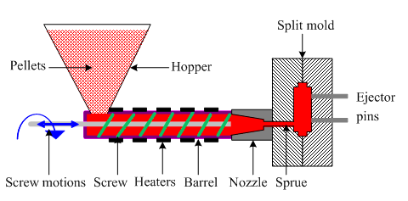

Injection Molding
Especially used for thermoplastic materials
Powder or granular resin is heated in a cylinder and injected at a controlled rate in a mould
Piston plunger or screw is used to force the material in mould.
Pressure upto 1758 kg/cm² (125 psi) is used
Once the article is formed mould is cooled and half mould is opened to remove the finished article.
Disadvantage of the method is formation of air bubbles or cavities in the articles
Applications: Smaller but large volume articles such as, pen caps, bottle caps, cups, containers, mechanical parts

Slide 15



Transfer Molding
The method combines features of both Compression Molding (hydraulic pressing of molding materials - thermosets) and Injection Molding (ram-plunger and filling the mold through a sprue).
The method is used especially for molding thermosetting resins (thermosets)
Products with relatively intricate designs could be fabricated with this method
Powdered raw materials are heated at certain low temperature to soften and then introduced through an orifice or sprue in the mould
Then it is cured in the mould at high temperature for certain time
Finally the moulded article is removed by separation of mould
Advantages:
Articles with intricate shapes could be designed
Aerospace and automobile parts, car body, helmets
The articles produced are blister free
Fine wires and glass fibers can be inserted in the mould
Even thick pieces can be cured completely and uniformly

Slide 16
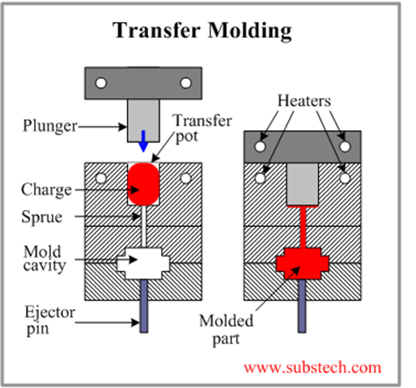
Transfer Molding

Slide 17
Extrusion Molding (Horizontal)
The method is used for the manufacturing of continuous type of thermoplastic articles with constant cross-section. Eg. Tubes, rods, strips, insulated electric cables
Dry powder or granules of thermoplastic materials are introduced through hopper and further melted by heating.
There are two types of extrusion moulding:
Vertical extruder moulding
Horizontal extruder moulding
Molten mass is pushed through the orifice of the die by using screw
Once the article leaves the orifice, it is allowed to pass through water for solidification
Proper temperature control of heating chamber and the speed of the screw are the major factors behind successful operation

Slide 18
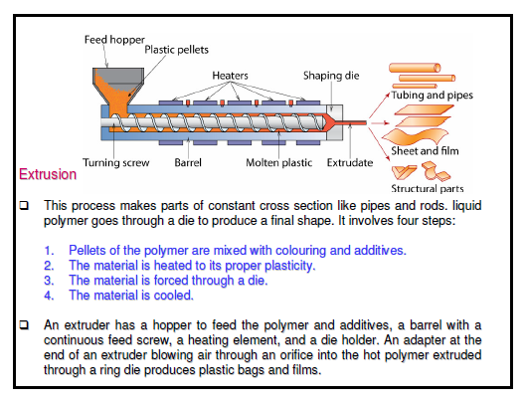



Extrusion Molding (Horizontal)

Slide 19
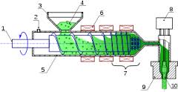
Extrusion Molding (Vertical)

Slide 20
 | Condensation polymerisation |  | Addition polymerisation
(1) | It is also known as step growth | (1) | It is also known as chain growth
 | polymerisation |  | polymerization
(2) | It takes place in monomers having | (2) | It takes place only in monomers
 | reactive functional groups |  | having multiple bonds.
(3) | It takes place with elimination of | (3) | It takes place without elimination of
 | simple molecule like H₂O,NH₃,HCl |  | simple molecule.
 | etc.,
(4) | Repeat units of monomers are | (4) | Repeat units & monomers are same.
 | different
(5) | The polymer is formed in gradual | (5) | Reaction is fast and polymer is formed
 | steps |  | at once.
(6) | The molecular mass of polymer | (6) | There is very little change in the
 | increases throughout the reaction |  | molecular mass throughout the
 |  |  | reaction
(7) | Product obtained may be | (7) | Product obtained are thermoplastic
 | thermosetting/thermoplastic
(8) | E.g.:- Bakelite, polyester ,polyamides | (8) | E.g:-Polyethylene, PVC, poly styrene.
 | etc.,

Slide 21

Conducting Polymers
Generally polymers are insulators because of the absence of free electrons.
But they can be made conductive in certain cases by the process called doping.
Two conditions for the polymer to become conducting are:
Polymers should possess conjugated double bonds
Polymer structure has to be disturbed either by adding or removing electrons by the process of doping.
There are 3 major classes of conducting polymers
Intrinsically conducting polymers
Doped conducting polymers
Extrinsically conducting polymers

Slide 22


1. Intrinsically conducting polymers
This belong to a class of organic materials consist of Conjugated pi-electrons in the backbone of their macromolecules which is responsible for high electrical conductivity.
In an electric field, conjugated pi-electrons of the polymer gets excited and can be transported through the solid polymer.
Overlapping of orbitals of conjugated pi-electrons over the entire backbone of the polymer results in the formation of valence bands and conduction bands. This induces conductivity in the presence of electric field.
For example:
Poly-acetylene, poly-aniline, poly-pyrolle and poly-thiophene etc.

Slide 23
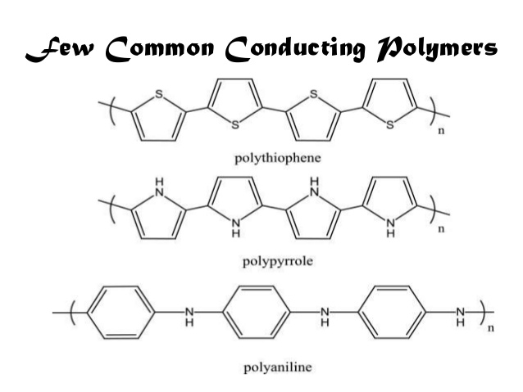


Polyacetylene

Slide 24




Due to their high electrical properties, ICPs are intensively investigated for application in electronics, microelectronics, optoelectronics mainly for areas in aerospace and automobile industries.
Among the most promising applications of the ICPs are corrosion protection, solid-state charge storage devices, electromagnetic screens, antistatic coatings and gas separation coatings.
However, poor mechanical properties, environmental sensitivity, moderate stability of electrical properties with temperature significantly limit the industrial applicability of ICPs.

Slide 25

2. (DCP) Doped conducting polymer
While the addition of a donor or an acceptor molecule to the polymer is called "doping", the reaction that takes place is actually a redox reaction.
The first step is the formation of a cation (or anion), which is called a soliton or a polaron.
Pn ⇔ [Pn + A – ] (reduction - oxidation)
As synthesized conductive polymers exhibit very low conductivities. It is not until an electron is removed from the valence band (p-doping) or added to the conduction band (n-doping, which is far less common) does a conducting polymer become highly conductive.
Doping (p or n) generates charge carriers which move in an electric field. Positive charges (holes) and negative charges (electrons) move to opposite electrodes. This movement of charge is what is actually responsible for electrical conductivity.

Slide 26




(DCP) Doped conducting polymer
This is obtained by exposing a polymer to a charge transfer agent in a gas phase or in solution.
Conductivity of ICPs can be increased by creating positive or negative charges on the polymer backbone by oxidation or reduction by the process of doping.
p-doping involves treating intrinsically conducting polymer with a Lewis acid thereby oxidation takes place and positive charges on the polymer backbone are created. Some common P-dopants are I₂, Br₂, AsF₅, PF₆ etc.

Slide 27
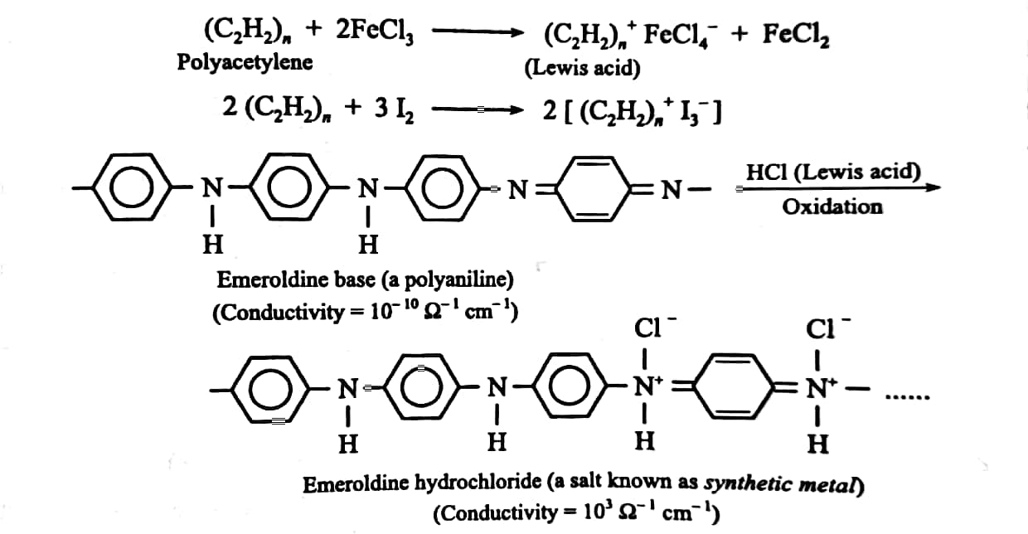

Slide 28
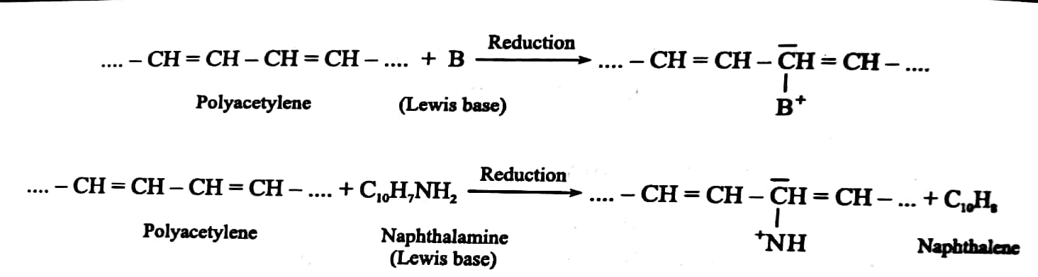

n-doping involves treating intrinsically conducting polymer with a Lewis base thereby reduction takes place and negative charges on the polymer backbone are created. Some common N-dopants are Li, Na, Ca etc.

Slide 29

3. Extrinsically Conducting Polymer
This type of conducting polymers possesses conductivity due to the presence of externally mixed conducting elements or compounds. These are of the following two types:
Conductive element filled polymer: Such polymers contains non-conducting polymers (behaving as binder) holds the conducting elements or compounds (behaving as conducting filler) such as carbon black, metals, metal oxides, etc. Such polymers possesses good bulk conductivity, low cost, light weight, mechanically tough and easily processable.
Blended conducting polymer: Such polymers are obtained by blending conventional polymers with conducting polymers either through physical or chemical process.

Slide 30
Applications of conducting polymers
In rechargeable light weight batteries
In optical display devices
In aircrafts and aerospace components
In diodes and transistors
In solar cells

Slide 31
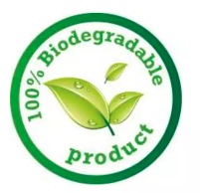
BIODEGRADBALE POLYMER

Slide 32


Biodegradable Polymer
Biodegradable polymers are polymers in which monomers are joined to one another by functional group linkage and has unstable link in backbone.
They are broken down to biologically accepted molecules that are metabolized and removed from the body via normal metabolic pathway.

Slide 33
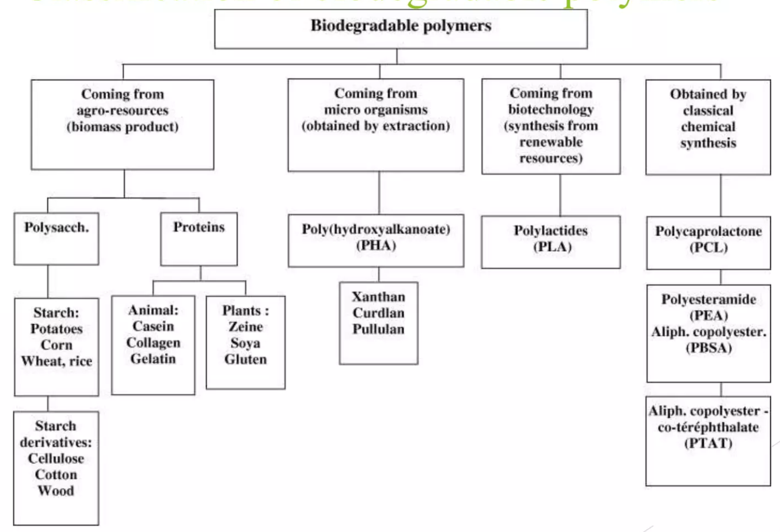

Slide 34


Biodegradation
It is process of converting polymer material into harmless, simple and gaseous products by the action of enzymes, micro-organism and water.
The process of biodegradation is threefold: first an object undergoes bio-deterioration, which is the mechanical weakening of its structure; then follows bio-fragmentation, which is the breakdown of materials by microorganisms; and finally assimilation, which is the incorporation of the old material into new cells.

Slide 35
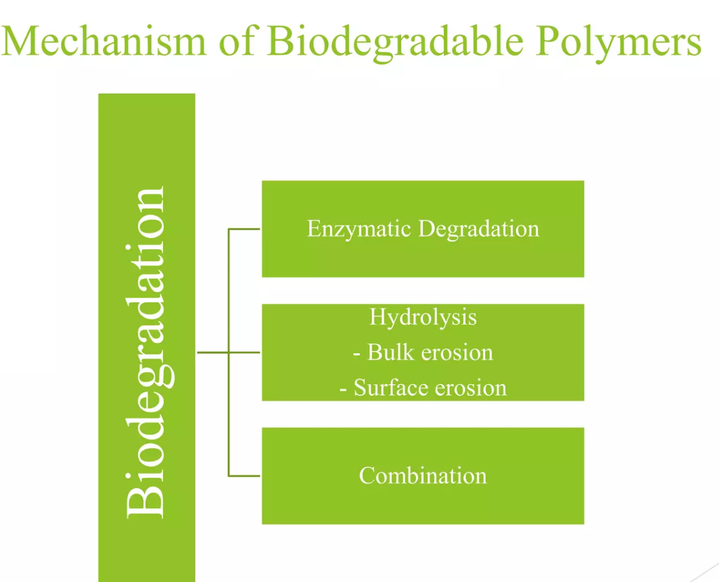
Notes:
In bulk erosion, mass loss occurs throughout the material following polymer hydration; water penetrates the polymer at a faster rate than it is broken down.
In surface erosion, degradation reactions are limited to the surface of the polymer material or occur at a significantly higher rate relative to diffusion rate of water into the bulk.

Slide 36







Advantages of Biodegradable polymer
Biodegradable Plastics Produce Less Emissions
Biodegradable Plastics = Less Waste
Petroleum Will Eventually Run Out
Growing crops to create biodegradable plastics can theoretically last forever, if there is good farmland available.
Combine this with renewable energy use and you have a winning combination for environmentally friendly production.
Biodegradable Plastics Can Decompose Quickly
Over the cycle of their decomposition, traditional plastics can release pollutants such as methane or bisphenol-A (BPA) (other than that phthalates such as BBP, DBP and DIBP), which can harm both the environment and human health. Bio-polymers don’t contain these chemicals and so when they biodegrade, our environment and our health aren’t affected.

Slide 37

Biodegradable products are usually seen as a key part of sustainable business practices.
Application in agriculture: time controlled biodegradable olefin can be used in agriculture for mulching, netting , twine, etc.
Biopolymer can be used as absorbable surgical implants, controlled release of drug, absorbable skin grafts and bone places to support the body recovery system.

